Slide 1
Optimizing Protein Titer Production Process using Interpretable Machine Learning Models
Presented by:
Paul Okafor
January 19th, 2024
Notes:
-Take your time
-Get the words right
-Anunciate

Slide 2
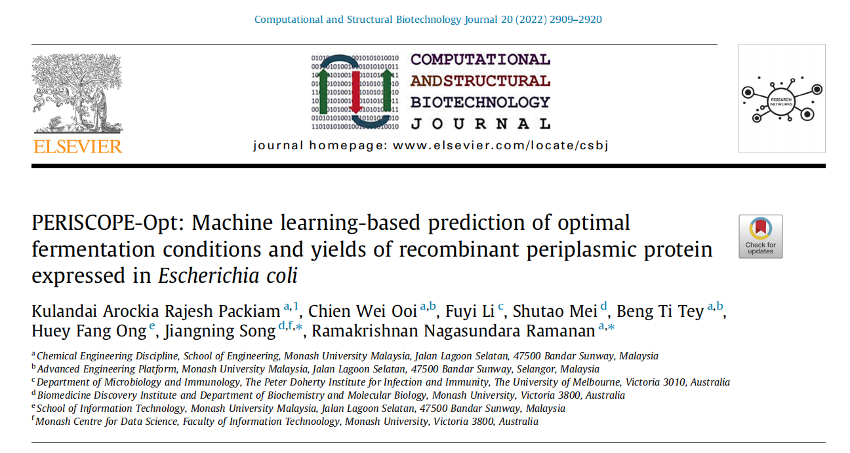

Slide 3

Outline
Introduction to Recombinant Protein Production
Key Terminology
Research that has been done
Future Direction
Notes:
-Mammalian, Bacteria, Yeast, or Insect
-Mammalian cells take longer
-CHO is fascinating, but very common in recombinant protein production industry

Slide 4
Introduction

Slide 5
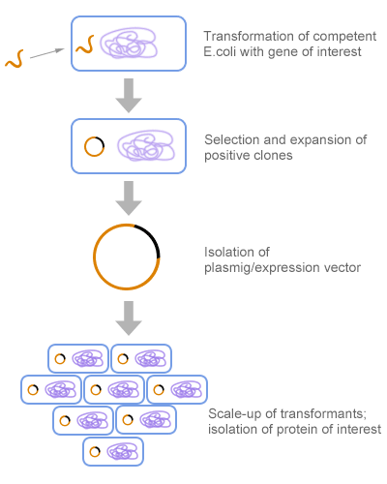
Introduction
Recombinant protein production using E. coli involves inserting a gene coding for the desired protein into the bacteria. These genetically modified E. coli are then cultivated in controlled conditions, where factors like temperature and nutrients are optimized for growth and protein production. The protein is either naturally produced or induced in the bacteria. After sufficient growth, the protein is harvested and purified from the E. coli cells or the surrounding medium
Notes:
Must format data first

Slide 6
Key terminology
Recombinant Proteins :
refers to a protein that is artificially made through the process of genetic recombination. This involves manipulating DNA sequences to produce a specific protein.
Escherichia coli (E. coli):
type of bacteria commonly found in the intestines of humans and animals. They are a versatile, fast-growing organism with the ability to rapidly multiply, making it ideal for efficiently producing proteins
Notes:
Genetic recombination is a natural process in which genetic material is exchanged between two different DNA molecules or rearranged within a single molecule

Slide 7
Key terminology
Host Cell (E. Coli)
Recombinant DNA (rDNA)
Plasmid
Transformation
Expression Vector
Protein Expression
Culture Medium
Notes:
Recombinant DNA (rDNA): The artificially created DNA that is inserted into the host organism. It's a combination of DNA from different sources.
Plasmid: A small DNA molecule within a cell that is physically separated from chromosomal DNA and can replicate independently. Used as a vector to transfer rDNA into E. coli bacteria. NB: the gene of interest (rDNA) is inserted into a plasmid. The plasmid then serves as a vehicle to introduce this recombinant DNA into a host organism, such as E. coli, for protein production
Transformation: The process of introducing foreign DNA into a bacterial cell, such as E. coli.
Expression Vector: the component or a condition that influences the expression of a gene. A plasmid or virus designed for protein expression in cells.
Host Cell: The cell into which the recombinant DNA is introduced, which in this case is E. coli.
Protein Expression: The process by which proteins are synthesized, modified, and regulated in living organisms. In recombinant DNA technology, it refers to the production of the protein coded by the introduced gene.
Culture Medium: The nutrient solution used to grow bacteria like E. coli in the lab. Nutrient solution typically contains sources of carbon (such as glucose), nitrogen, minerals, vitamins, and other essential nutrients.
rDNA, or recombinant DNA, is a form of DNA that has been created artificially by combining genetic material from multiple sources. In the context of producing recombinant proteins using E. coli, rDNA is the genetically engineered DNA that is introduced into the E. coli bacteria (the host organism). This rDNA contains the gene that codes for the protein you want to produce. Once the rDNA is inside the E. coli cells, these cells use the genetic instructions in the rDNA to produce the recombinant protein.

Slide 8
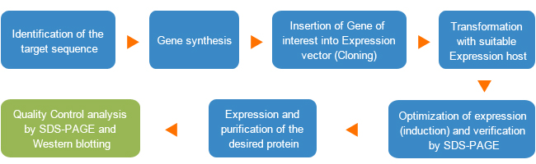
Introduction
Procedure for Recombinant protein production/expression/purification
The goal is to use Machine Learning techniques to optimize these steps
Notes:
Must format data first

Slide 9
LITERATURE REVIEW

Slide 10
Literature Review
Research that focus on features with respect to Amino Acid Sequence
Research that focus on the Influence of fermentation process conditions
Involves environmental and procedural factors for microorganism growth.
Key factors: temperature, pH, nutrient availability, oxygen levels.
Optimization is crucial for maximizing protein yield and quality
amino acid sequence refers to the specific order of amino acids that make up the protein
Determined by the gene's DNA in rDNA.
Dictates the specific order of amino acids.
Essential for the protein's structure and function
Notes:
Amino Acid Sequence: This is like a recipe for the protein, directly determines the structure and function of the protein being produced
In recombinant protein production, the amino acid sequence refers to the specific order of amino acids that make up the protein being produced. This sequence is determined by the gene inserted into the host organism (like E. coli). The gene's DNA sequence encodes the information needed to assemble amino acids in the correct order to form the desired protein. The accuracy of this amino acid sequence is crucial, as it determines the structure and function of the resulting recombinant protein.
Fermentation Process Conditions: These include various environmental and procedural factors involved in growing microorganisms (like E. coli) in a controlled setting to produce proteins. Factors like temperature, pH, nutrient availability, and oxygen levels are all part of the fermentation process conditions. Optimizing these conditions is crucial for maximizing the yield and quality of the produced protein.

Slide 11
Literature Review
PROSO II
ccSOL Omics
Prediction of protein solubility
Protein-Sol
DeepSol
PARSnIP
Focus on features with respect to Amino Acid Sequence
SoITranNet
K-Fold
Prediction of protein Folding rate
Pred-PFR
PRORATE
Notes:
In recombinant protein production, the amino acid sequence refers to the specific order of amino acids that make up the protein being produced. This sequence is determined by the gene inserted into the host organism (like E. coli). The gene's DNA sequence encodes the information needed to assemble amino acids in the correct order to form the desired protein. The accuracy of this amino acid sequence is crucial, as it determines the structure and function of the resulting recombinant protein.
Protein folding rate refers to the speed at which a protein molecule assumes its functional three-dimensional shape

Slide 12
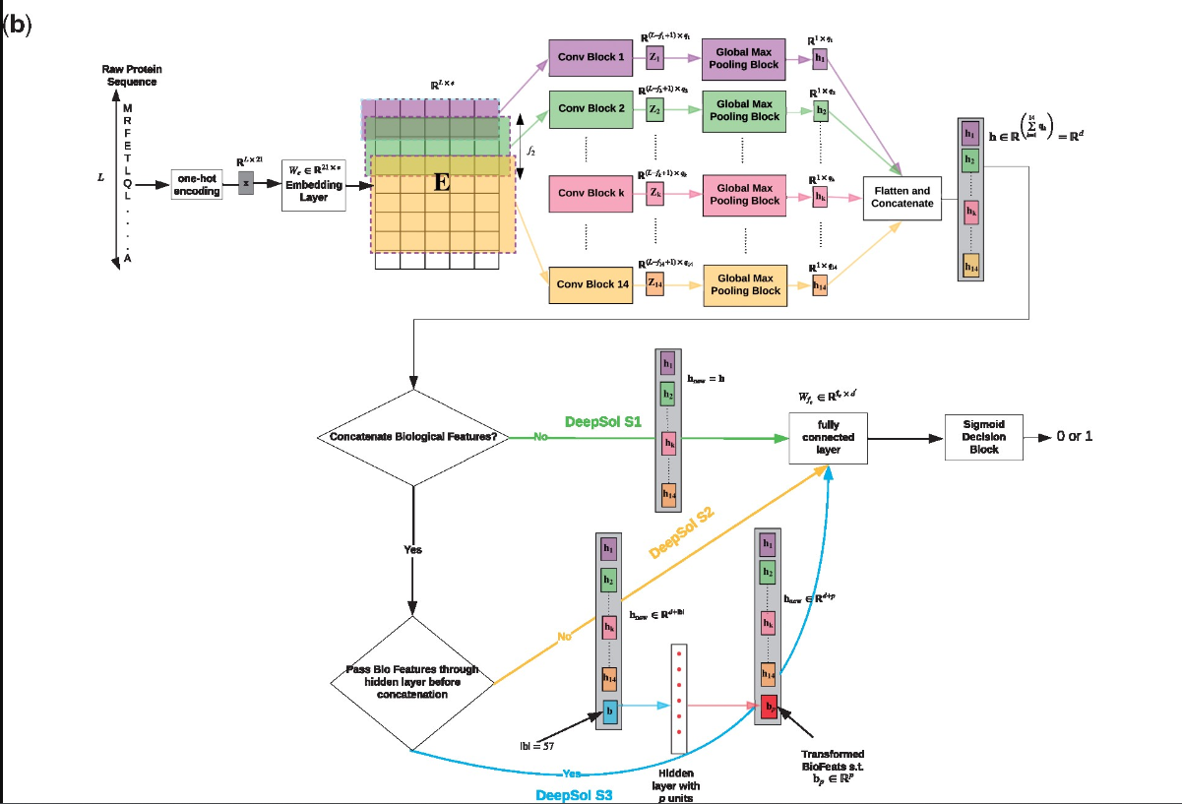
Literature Review
DeepSol: a deep learning framework for sequence-based protein solubility prediction (Khurana et al., 2018)
accuracy = 77%
Matthew’s correlation coefficient = 0.48
Data Input: Raw protein sequences are inputted using a one-hot encoding scheme.
Convolutional Neural Network (CNN): Convolutional layers extract pattern features from sequences.
Pooling Layers: These reduce data dimensionality, keeping only the most vital features.
Additional Features: Structural information from protein sequences is integrated.
Fully Connected Layers: Synthesize features into a predictive solubility score.
Output: The model predicts solubility as a binary outcome (soluble or not).
Notes:
The framework depicted in the diagram for sequence-based protein solubility prediction uses a deep learning approach. Here’s a high-level explanation:
Input: The raw protein sequences are encoded using a one-hot encoding method, which is a common way to represent categorical data in numerical form for machine learning models.
Embedding Layer: The encoded sequences are passed through an embedding layer, which creates dense representations of the sequences that capture more information than the one-hot encoding.
Convolutional Blocks: Several convolutional layers are used to process the sequence data. These layers can detect patterns within the sequence that are important for predicting solubility.
Global Max Pooling: After convolutional layers, global max pooling is applied to reduce the dimensionality of the data while retaining the most significant signals.
Concatenation of Features: The output from the global max pooling is then concatenated with additional biological features derived from the protein sequence. These may include structural information that's crucial for predicting solubility.
Fully Connected and Output Layer: The concatenated features are fed into fully connected layers, ending with a sigmoid layer that predicts whether the protein is soluble or not (output as 0 or 1).

Slide 13
Literature Review
PERISCOPE-Opt
Focus on the Influence of fermentation process conditions
Domenico et al. (2023)
??
Notes:
In recombinant protein production, the amino acid sequence refers to the specific order of amino acids that make up the protein being produced. This sequence is determined by the gene inserted into the host organism (like E. coli). The gene's DNA sequence encodes the information needed to assemble amino acids in the correct order to form the desired protein. The accuracy of this amino acid sequence is crucial, as it determines the structure and function of the resulting recombinant protein.

Slide 14
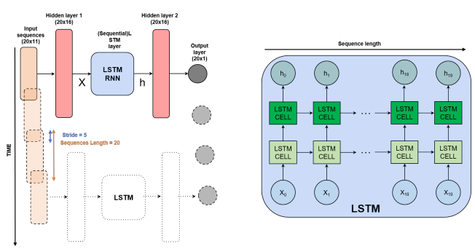
Literature Review
A Deep Learning Approach to Optimize Recombinant Protein Production in Escherichia coli Fermentations (Domenico et al., 2023)
The study uses machine learning, specifically RNN and LSTM, to predict OD600nm values (Optical density values).
OD 600 measures the concentration of bacteria in a liquid culture, such as E. coli in recombinant protein production.
The goal is to optimize the production of inclusion bodies for neurotrophin recombinant protein.
The ML models achieved promising results for real-time yield estimation.
Notes:
OD600nm, or optical density at 600 nanometers, is a measurement used in microbiology to estimate the concentration of bacteria in a liquid culture, such as E. coli in recombinant protein production. It is based on the principle that bacterial cells scatter light, and the amount of light scattered is proportional to the cell density. By measuring the OD600nm, researchers can determine the growth phase of the culture and decide the optimal time to induce the expression of the recombinant protein.
It helps decide when to start the protein-making process. The more light blocked, the more bacteria there are.

Slide 15
Literature Review
PERISCOPE-Opt: Predicting optimal fermentation conditions and yields of recombinant periplasmic protein expressed in Escherichia coli (Kulandai et al., 2022)
The study uses both fermentation conditions and amino acid sequence features in ML modeling.
two sets of XGB classifiers in the first stage to classify the expression level of the given protein as low, medium or high class.
Three sets of regression models (SVM and Random Forest) to quantify the protein yield with respect to each class in the second stage.
The model achieved 75% accuracy and a 0.91 Pearson correlation coefficient for correct predictions.
Notes:
The framework depicted in the diagram for sequence-based protein solubility prediction uses a deep learning approach. Here’s a high-level explanation:
Input: The raw protein sequences are encoded using a one-hot encoding method, which is a common way to represent categorical data in numerical form for machine learning models.
Embedding Layer: The encoded sequences are passed through an embedding layer, which creates dense representations of the sequences that capture more information than the one-hot encoding.
Convolutional Blocks: Several convolutional layers are used to process the sequence data. These layers can detect patterns within the sequence that are important for predicting solubility.
Global Max Pooling: After convolutional layers, global max pooling is applied to reduce the dimensionality of the data while retaining the most significant signals.
Concatenation of Features: The output from the global max pooling is then concatenated with additional biological features derived from the protein sequence. These may include structural information that's crucial for predicting solubility.
Fully Connected and Output Layer: The concatenated features are fed into fully connected layers, ending with a sigmoid layer that predicts whether the protein is soluble or not (output as 0 or 1).
a. Expression levels refer to the amount of protein that is being produced by the cells at the genetic level
b. Yield, on the other hand, refers to the total amount of protein that can be recovered from the production process. It's not just about how much is produced but also how much is actually available at the end of the process

Slide 16
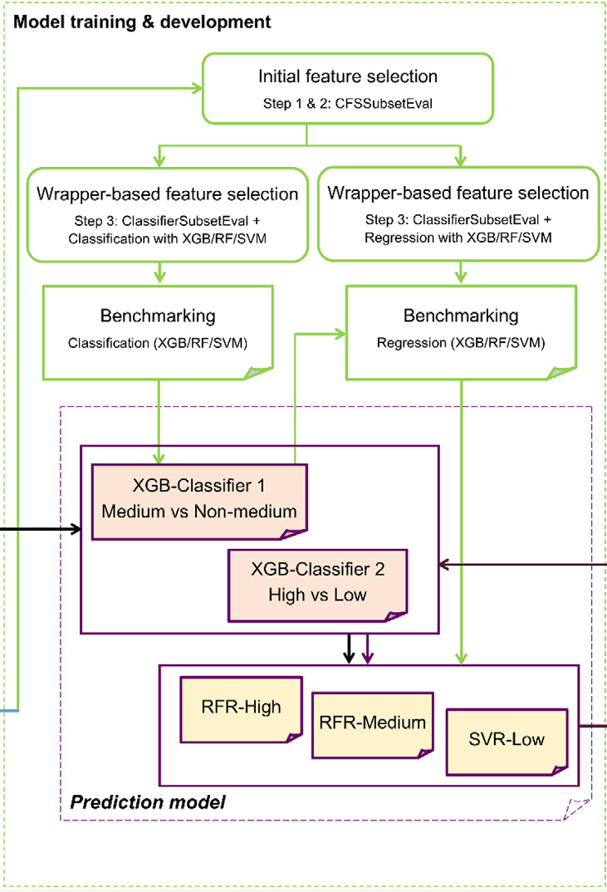
Literature Review
PERISCOPE-Opt: Predicting optimal fermentation conditions and yields of recombinant periplasmic protein expressed in Escherichia coli (Kulandai et al., 2022)
Study Data Components:
A total of 461 datasets were collected for 84 different proteins.
Focus on the amino acid sequence of a specific recombinant protein and the parameters of the fermentation process conditions.
Measurement of protein expression yield in E. coli periplasm (mg/L).
Analysis of various fermentation process parameters.
Notes:
The framework depicted in the diagram for sequence-based protein solubility prediction uses a deep learning approach. Here’s a high-level explanation:
Input: The raw protein sequences are encoded using a one-hot encoding method, which is a common way to represent categorical data in numerical form for machine learning models.
Embedding Layer: The encoded sequences are passed through an embedding layer, which creates dense representations of the sequences that capture more information than the one-hot encoding.
Convolutional Blocks: Several convolutional layers are used to process the sequence data. These layers can detect patterns within the sequence that are important for predicting solubility.
Global Max Pooling: After convolutional layers, global max pooling is applied to reduce the dimensionality of the data while retaining the most significant signals.
Concatenation of Features: The output from the global max pooling is then concatenated with additional biological features derived from the protein sequence. These may include structural information that's crucial for predicting solubility.
Fully Connected and Output Layer: The concatenated features are fed into fully connected layers, ending with a sigmoid layer that predicts whether the protein is soluble or not (output as 0 or 1).
a. Expression levels refer to the amount of protein that is being produced by the cells at the genetic level
b. Yield, on the other hand, refers to the total amount of protein that can be recovered from the production process. It's not just about how much is produced but also how much is actually available at the end of the process

Slide 17
Future Direction

